Slide 1
Sprint-2 Data Visualization Charts
Date : 04 /11/ 2022
Team ID :PNT2022TMID43579
Project Name :Estimate The Crop Yield Using Data Analytics

Slide 2
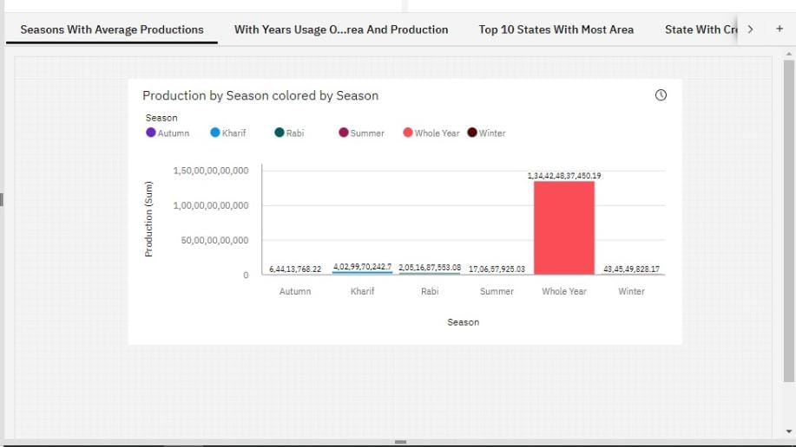
Seasons With Average Productions

Slide 3
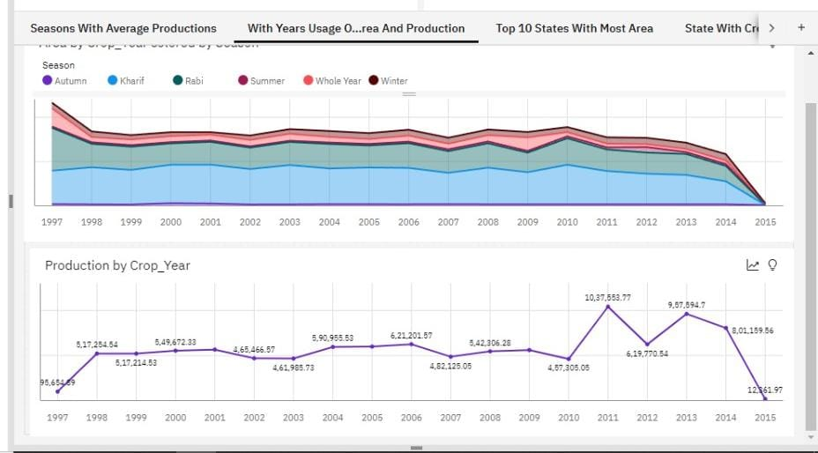
With Years Usage Of Area And Production

Slide 4
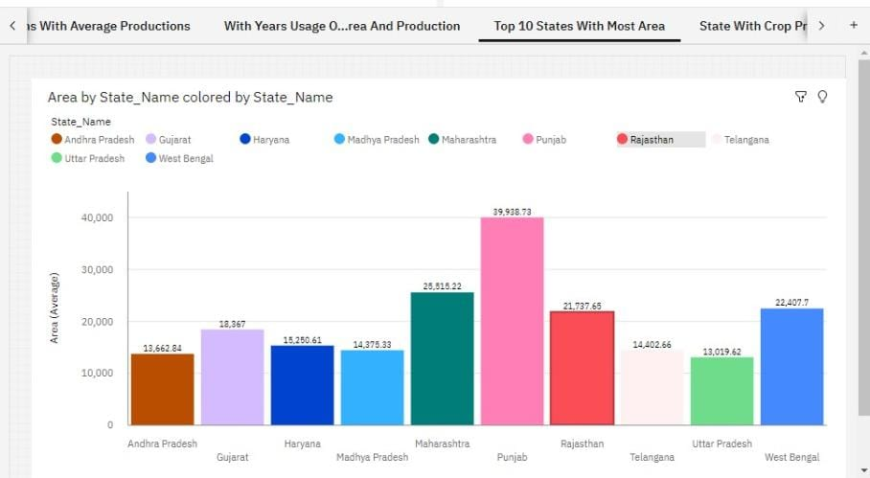
Top 10 States With Most Area

Slide 5
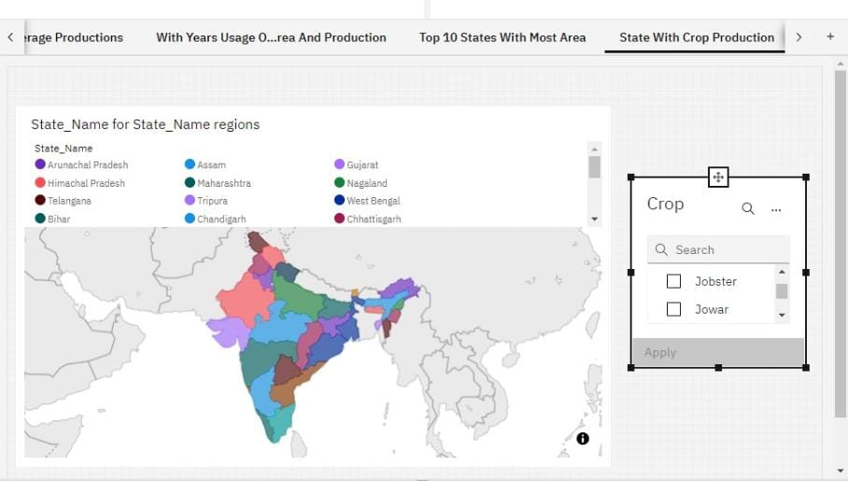
State With Crop Production

Slide 6
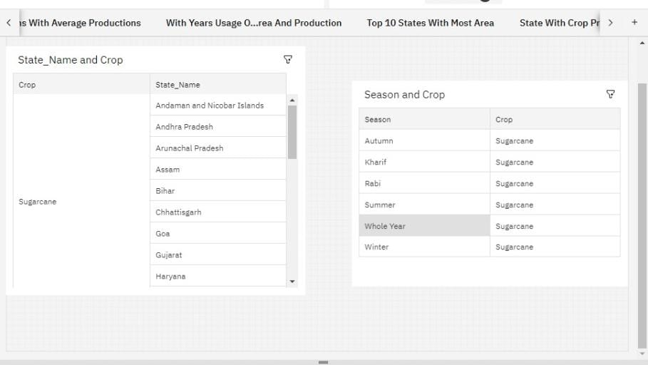
States With The Crop Production Along With Season (Text Table)

